Slide 1
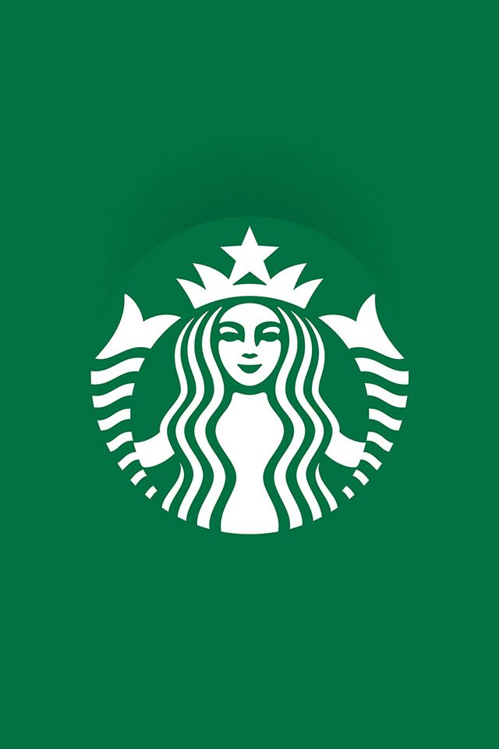
Starbucks Market Analysis
Abhijit Morye

Slide 2
Agenda
Objective
About Starbucks
Different Data sources of Starbucks
Understanding data collected from different sources
Areas to be focused on for marketing
Starbucks Stores Location Analysis

Slide 3
Objective
Analyzing available Starbucks’s big data to draw better decisions that will help Starbucks to strengthen its position as a global leader in the coffee and snack industry.

Slide 4
About Starbucks
American multinational chain of coffeehouses and roastery reserves founded in 1971 and headquartered in Seattle, Washington.
32,660 stores in 83 countries including 16,637 company operated stores and 16,023 licensed stores.
Starbucks locations serve hot and cold drinks, whole-bean coffee, micro-ground instant coffee, espresso, caffe latte, full and loose-leaf teas, juices, Frappuccino beverages, pastries, and snacks.
Total revenue of 23.51 billion dollars earned from beverages and food products in year of 2020.
Total Starbucks employee count is 3,49,000 in 2020.
Starbucks also markets their products through other channels such as licensed stores, grocery and national foodservice accounts.

Slide 5
Different Data sources of Starbucks
The company completes over 100 million transactions per week across globe. During these transactions, Starbucks collects vast amount data from different channels.
Below are the channels through which Starbucks collects their customer data.
  In-store customer purchasing patterns.
  Data collected from Starbucks mobile application.
  Data collected through loyalty cards program.
  Data collected from customer market research i.e. survey.
  Demographic data.

Slide 6
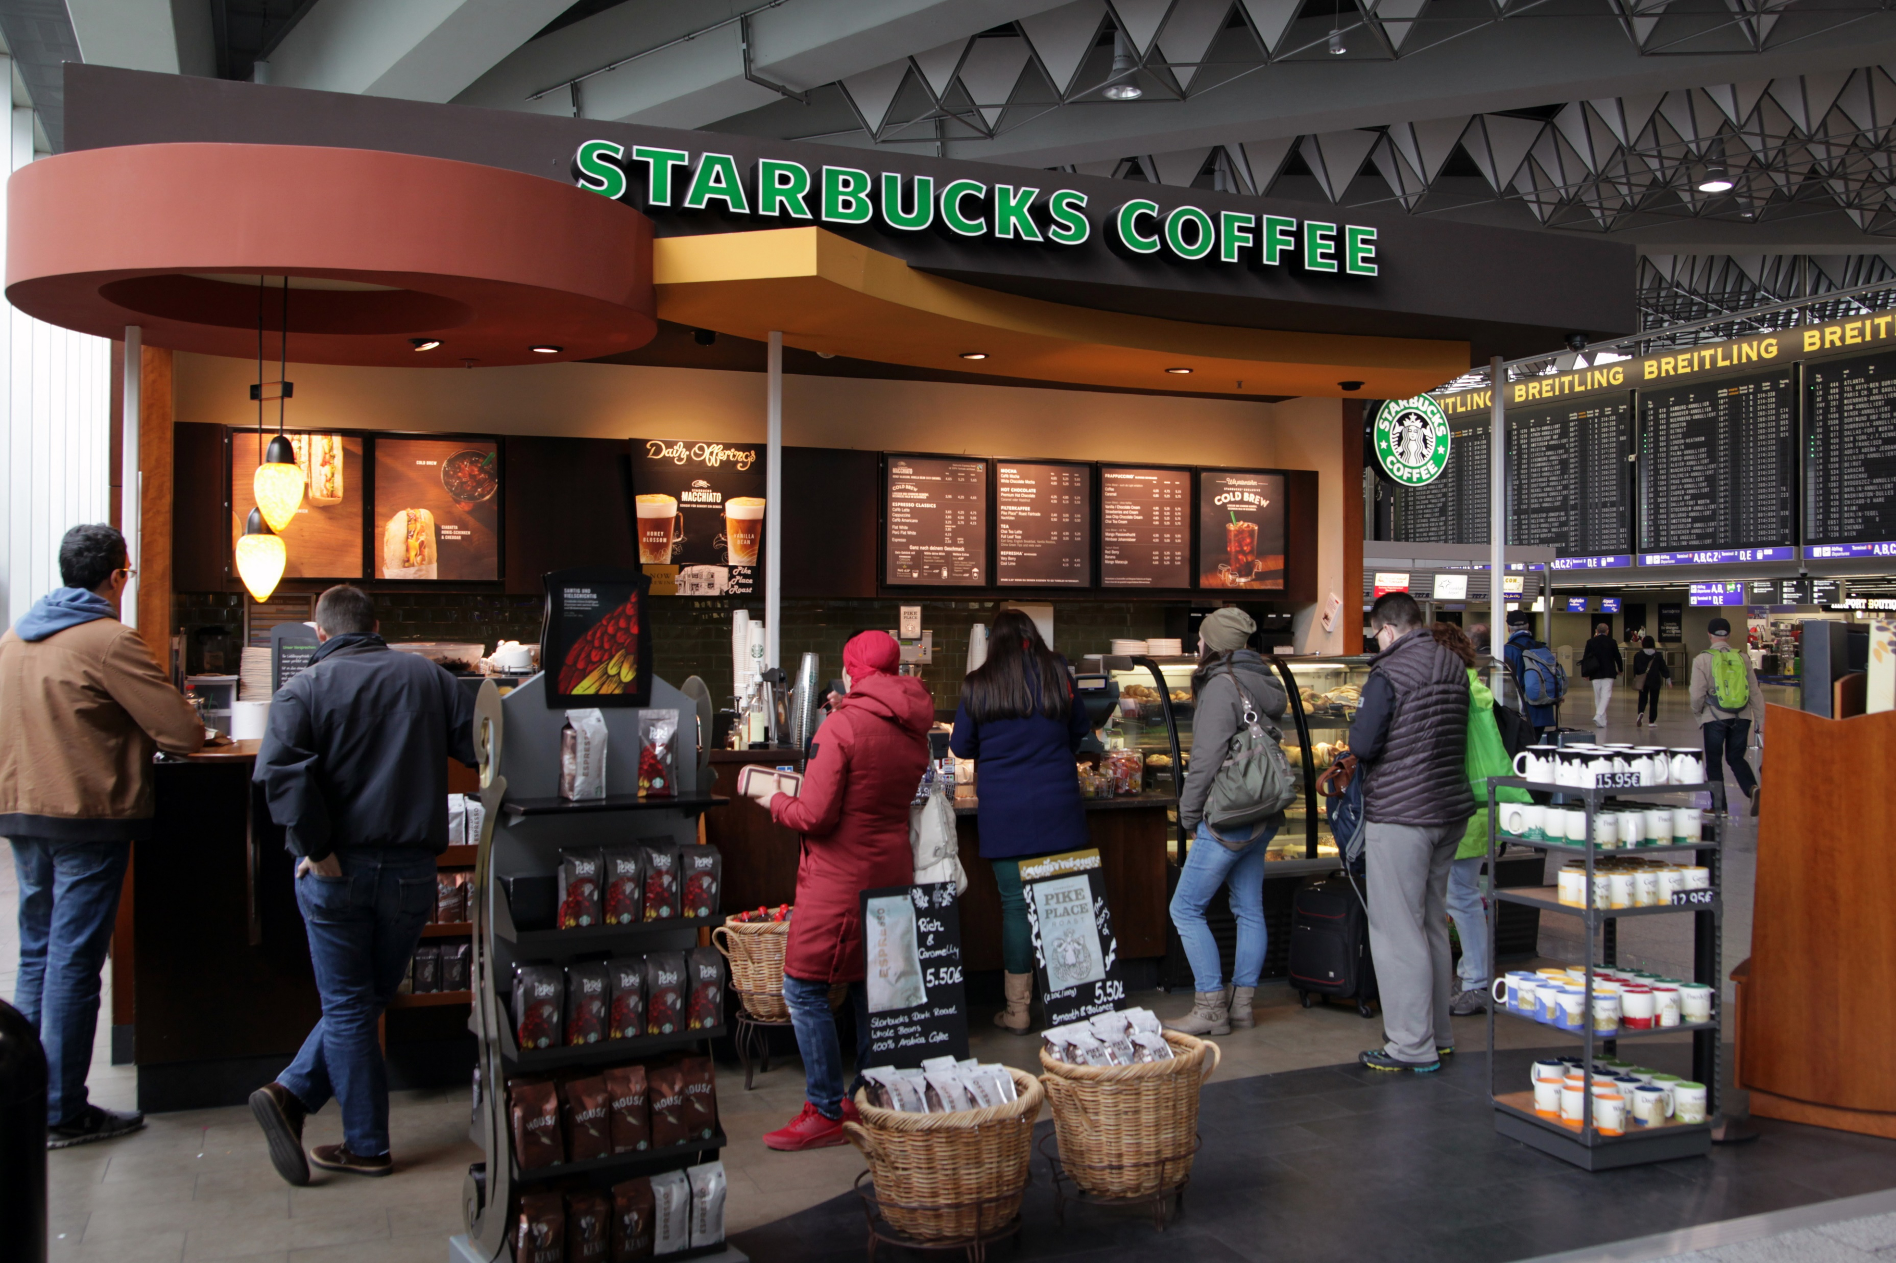
Understanding data collected from different sources
  In-store customer purchasing patterns –
    Different data such as at what time there would be more rush at the
    store, e.g. morning/afternoon/night
    Data about people who visit stores such as age groups, gender
    Data about payment methods used by customers at the stores,
    e.g. by cash, by cards
    Data about which drinks or beverages and food snacks are famous
    at particular stores, e.g. latte, cappuccino
    Data about purchasing patterns which is affected by the cultural and regional aspects of locations in which store is located.

Slide 7
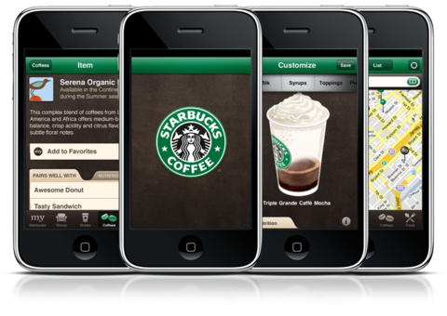
Understanding data collected from different sources
  Data collected from Starbucks mobile application –
    Data collected at the time of user registrations such as name,
    age, gender, address, income, preferred payment method,
    card details, contact info, occupation, email ids
    Data about when in a day and from where user place an order for
    drinks or foods.
    Data about how many orders Starbucks receive within particular
    location in city.
    How frequently customer place an orders in a day using an application
    Customer’s browsing patterns of beverages and foods
    Preferred choice of drinks and snacks of single customer.

Slide 8
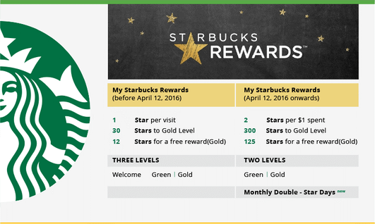
Understanding data collected from different sources
  Data collected through loyalty cards program –
    Number of customers who opted for loyalty card and
    their information such as name, age, gender, email ids,
    address, contact info
    Data about usage of loyalty cards by customers at
    grocery shop to but Starbucks’s products,
    e.g. frequency of usage of cards.
    Based on purchasing frequency of customer at Starbucks
    and numbers of rewards a customer get, identifying
    frequent buyer of Starbucks products.

Slide 9
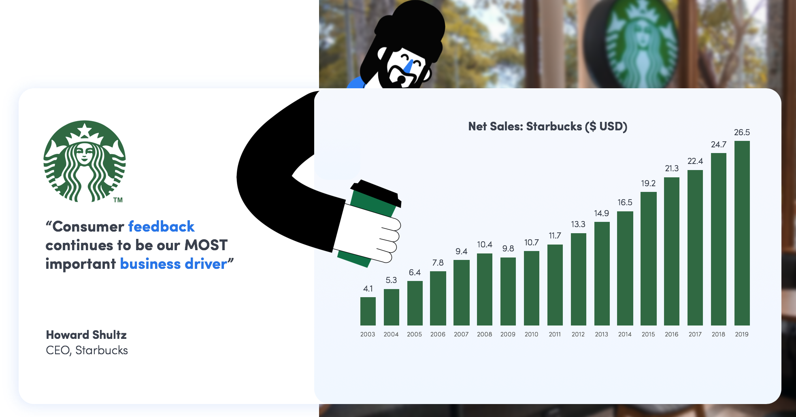
Understanding data collected from different sources
  Data collected from customer market research –
    Data collected through cultural trends, analysing
    social media platforms, consumer feedback
    Starbucks launched “My Starbucks Idea Platform”
    to enable their employees to provide feedback according to
    customers purchasing patterns, e.g. idea for new products
    at Starbucks, request to bring back old products based on
    change in customer's purchasing trends.
    Feedbacks received through different social media such
    as Facebook, Instagram about Starbucks offerings.
    Data collected through different surveys conducted by
    Starbucks, e.g. preferred time of a day to drink coffee, the most
    preferred coffee in particular locations, feedback on use of types
    milks or other ingredients by Starbucks

Slide 10
Understanding data collected from different sources
  Demographic data –
    Data about locations in which current Starbucks store is operating, e.g. weather conditions, number of public holidays and special promotional data during that period.
    Data associated with people of particular locations, e.g. average income, age groups, gender ratio, population of location
    Other data such as number of corporate offices in given area and buying habits of corporate people at Starbucks.
    Number of Starbucks stores in a particular area.

Slide 11
Areas to be focused on for Marketing
Based on available big data collected from different sources by Starbucks, below are the main areas where marketing strategy can be derived to boost business.
        Personalized customer experience at Starbucks
        Optimizing menu design and various offerings at Starbucks
        Determining new locations of Starbucks stores
        Supply chain management

Slide 12
Areas to be focused on for Marketing
Personalized customer experience at Starbucks –
  Based on the user's current location, preferred timing of a day to order, purchasing history, different offerings can be offered to various customers.
  Based on previous purchasing trends, the new product can be shown to customers which have been not tried out by the consumer.
  Based on particular dietary patterns of consumers, personalized beverages and foods can be offered to such consumers.
  Using customers more preferred time of day for purchasing, different bonuses and loyalty points can be given to consumers to attract more customers.

Slide 13
Areas to be focused on for Marketing
Optimizing menu design and various offerings at Starbucks –
  Based on customers purchasing trends, new menu can be introduced for consumers.
  Based on geographic locations of store and various aspects of particular locations such as weather, population density, preferred choices towards particular coffee or food, continuous upgradations to menu can be done in order to attract more customers.
  Along with beverages and foods, different aspects of store such as ambience, size of cups can be regularly updated to boost business.

Slide 14
Areas to be focused on for Marketing
Determining new locations of Starbucks stores –
  Using demographic as well geographical data, location of new store can be determined.
  Various factors such as population density, prices of lands, weather, holiday seasons, traffic information, other near by stores including competitor's stores, profitability of new location can be predicted.
  Once the location is fixed and store is open to serve customer, continuous upgradation of store design can be performed to attract people from different age group as well as people from different cultures.

Slide 15
Areas to be focused on for Marketing
Supply chain management –
  Data derived from geographic as well as from consumer dataset, various goods the are used for making beverages and foods can be optimized.
  Based on the most customer’s preferred time of coffee, maintenance of machines can be performed for smooth and continuous operation of store.
  Once the location is fixed and store is open to serve customer, continuous upgradation of store design can be performed to people from different age group as well as people from different cultures.

Slide 16
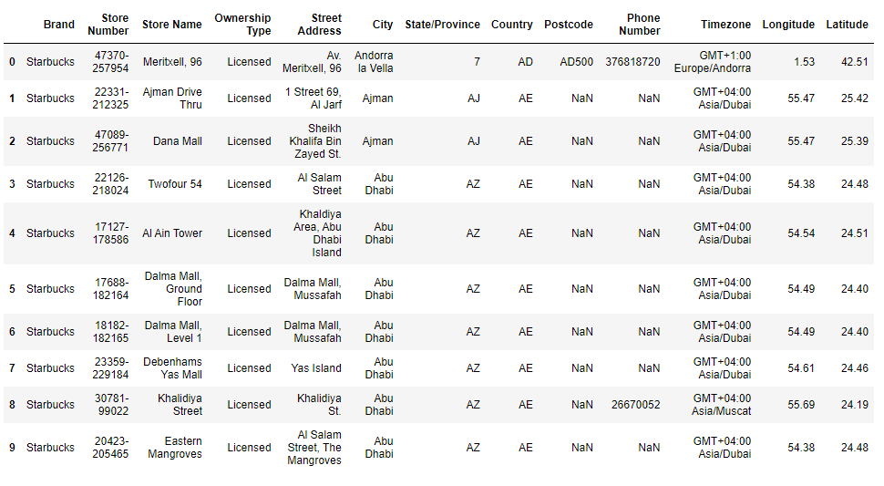
Starbucks Stores Location Analysis
Starbucks has stores spread across the world. Below is the snapshot from csv file which has details about Starbucks stores across the world.

Slide 17
Details of columns in CSV file
Brand – Brand under which Starbucks operate
Store Number – Number of store
Ownership Type – Ownership Types i.e. Company owned, License Based, Joint Venture
Street Address – Address of the store
City – City of store
State/ Province – State in which store is located
Country – Country of store
Postcode – Postcode of store
Phone Number – Phone number of store
Time zone – Time zone under which store comes in
Longitude & Latitude – Longitude and Latitude of store

Slide 18
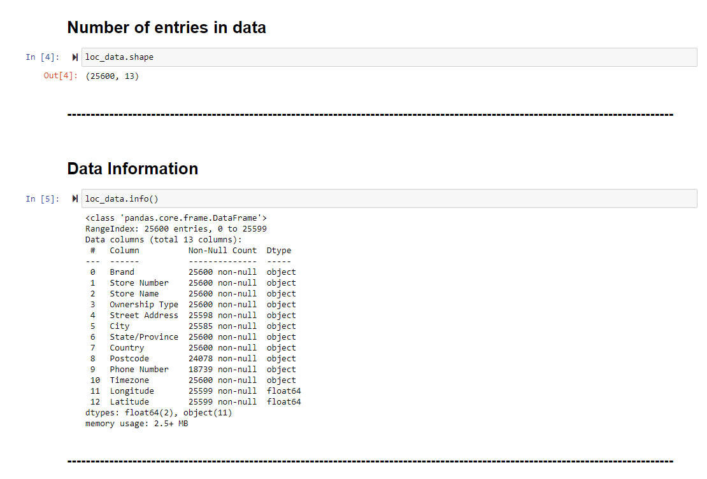
Size and Information about data
CSV file consist of total 25,600
records about each stores across
the world.

Slide 19
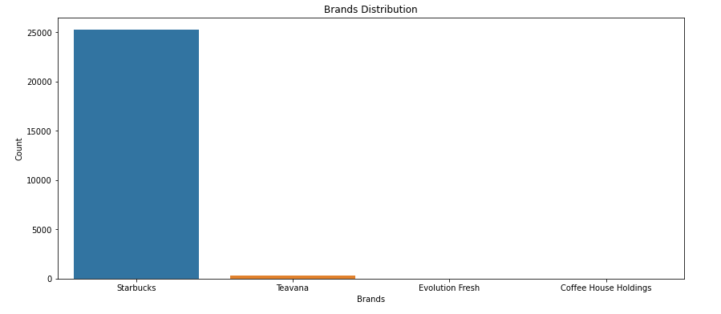
Distribution of Brands names under which Starbucks operates
Below is distribution of Starbucks brand name
In various countries.
Brand Name | Counts
Starbucks | 25249
Teavana | 348
Evolution Fresh | 2
Coffee House Holding | 1

Slide 20
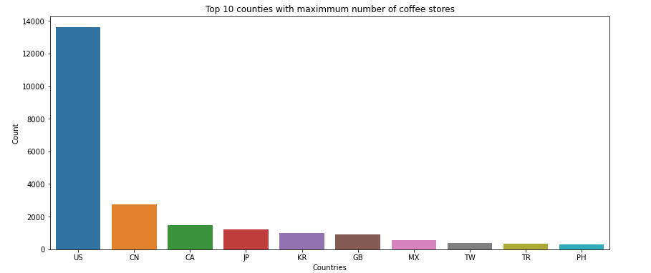
Top 10 counties with maximum number of coffee stores

Slide 21
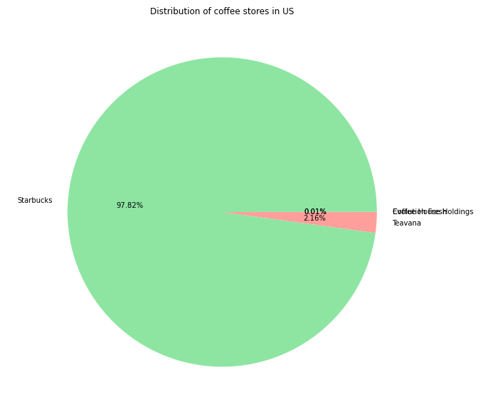
Distribution of coffee stores in US
Below is brands name under which Starbucks operates in USA
Brands | Count
Coffee House Holdings | 1
Evolution Fresh | 2
Starbucks | 13311
Teavana | 294

Slide 22
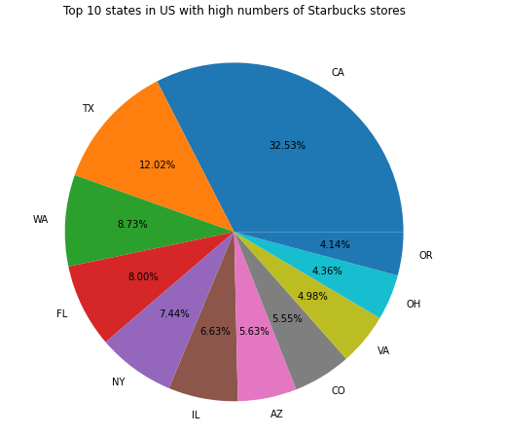
Top 10 states in US with high numbers of Starbucks stores
California in USA has 32.53% of total number Starbucks stores

Slide 23
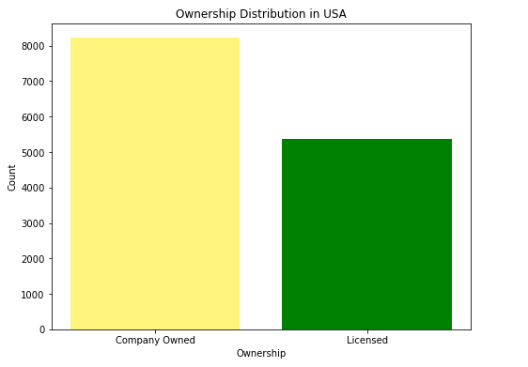
Distribution of Ownership of stores in USA
Company owned Starbuck are more in number than licensed.

Slide 24
Top 10 counties with maximum number of coffee stores

Slide 25
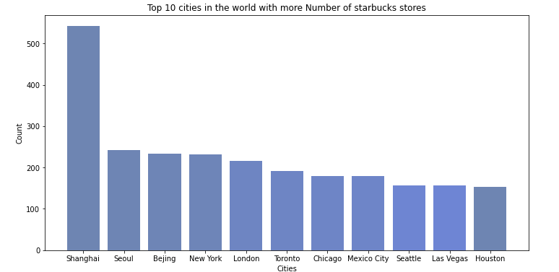
Top 10 cities in the world with more Number of Starbucks stores
Shanghai in China has more number of Starbucks stores according to data.

Slide 26
Link for Jupyter notebook for Starbucks store location analysis to analyse the Starbucks market in different countries based on demographic Data.
https://github.com/abhijitmorye/Data_Analysis_and_Visulization.git

Slide 27
References -
https://digital.hbs.edu/platform-digit/submission/starbucks-secret-ingredient-data-analytics/
https://www.forbes.com/sites/bernardmarr/2018/05/28/starbucks-using-big-data-analytics-and- artificial-intelligence-to-boost-performance/?sh=3df2e60065cd
https://en.wikipedia.org/wiki/Starbucks
https://demand-planning.com/2018/05/29/how-starbucks-uses-predictive-analytics-and-your-loyalty-card-data/
https://www.thebalancesmb.com/starbucks-use-of-market-research-propels-the-brand-2297155
https://www.kaggle.com/umeshnarayanappa/explore-starbucks-worldwide-stores/data

Slide 28
Thank You

